Slide 1
Machine Learning in Practice I
Lecture 11
Antal Jakovac, 2025

Slide 2
Extreme Learning Machine

Slide 3


Extreme Learning Machine
what is the best basis to represent the output?
  perceptron, linear SVM → linear basis
  nonlinear SVM → arbitrary fixed kernel
DNNs: multilayer structure → preceding layers + last layer
  preceding layers → generate the basis, fitted to the problem
  last layer → use linear combination of basis elements
Extreme Learning Machine (ELM)
  use a random basis → technically a layer with fixed weights

Slide 4
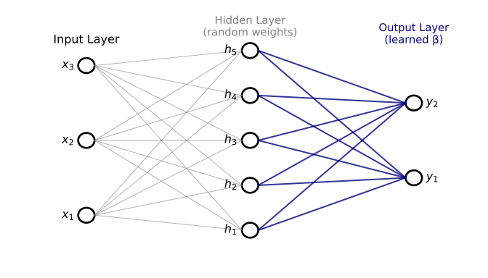
Extreme Learning Machine
data in matrix representation:
define an intermediate basis:
  is a pointwise non-linear function
  (e.g. tanh, or Gaussian)
  fixed parameters
expand Y in this basis:
  tunable parameters
  best value from minimizing the chi-squared function (use regularization!)

Slide 5
Extreme Learning Machine
simple package for ELM
# ELM package
import numpy as np
class ELM:
def __init__(self, n_hidden=50, activation=np.tanh):
self.n_hidden = n_hidden
self.activation = activation
def fit(self, X, y):
self.W = np.random.randn(X.shape[1], self.n_hidden) self.b = np.random.randn(self.n_hidden)
H = self.activation(X @ self.W + self.b)
self.beta = np.linalg.pinv(H) @ y
def predict(self, X):
H = self.activation(X @ self.W + self.b)
return H @ self.beta

Slide 6
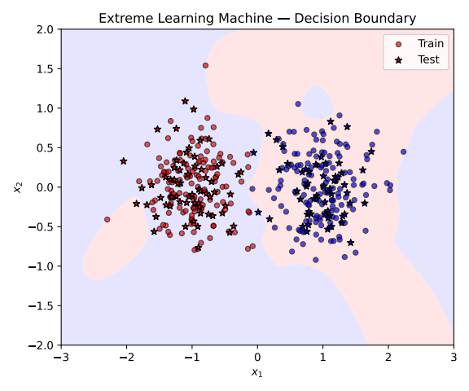
Extreme Learning Machine
example dataset
activation function: tanh
accuracy: 97%

Slide 7
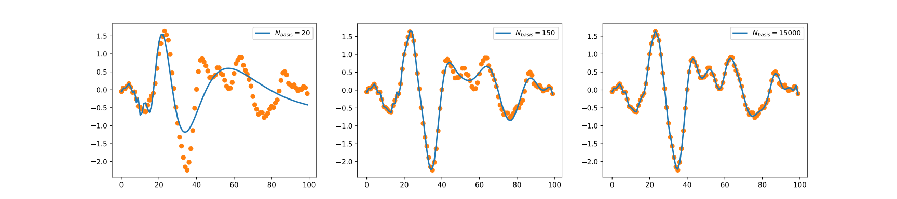
Extreme Learning Machine
function fitting with ELM
random function, and differen hidden layer dimensions
basis not too effective to describe highly oscillating functions

Slide 8
Gaussian representation of data distribution

Slide 9
Gaussian Mixture Models
interconnected data are often sit in a compact region → ellipsoid
find the ellipsoid containing most of the data!
probability level → “distance”
equidistance surfaces constant → ellipsoids
generate points: →

Slide 10
Gaussian Mixture Models
technical slide: equipotential surfaces from correlation matrix
we want to satisfy
eigensystem eigenvectors orthogonal
ansatz:
verify:

Slide 11
Principal Component Analysis (PCA)
technical slide: generate data with given
  data with normal distribution:
  transform it
  check:
  for 2D data we can directly specify the direction:
# generating Gaussian with given mu and C
def generate_Gaussian(mu, C, Ndata):
dim=mu.shape[0]
xi = np.random.normal(0,1, (dim, Ndata))
lam,ev =np.linalg.eigh(C)
sqrt_C = ev@np.diag(np.sqrt(lam))@ev.T
return sqrt_C@xi + mu

Slide 12
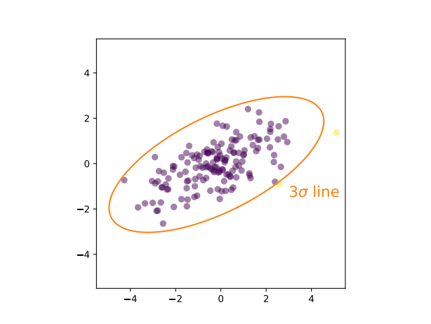
Gaussian Mixture Models
example: 2D points
  generate points
  numerically determine correlation matrix and eigensystem
  draw ellipses containing 99% of data → about 3σ in 2D

Slide 13
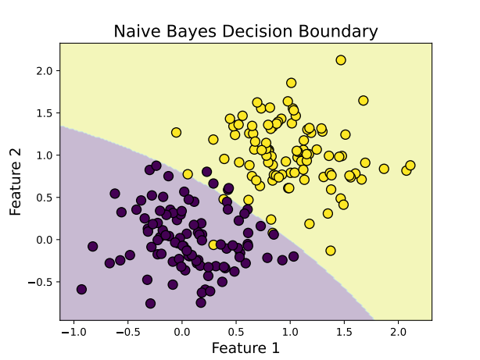
Gaussian Mixture Models
if we have several classes → Naive Bayes models
  assume that each class are independent and points lie in an ellipsoid → can be represented by Gaussian distribution
  determine the probability to belong to each classes separately
# Naive Bayes classification
from sklearn.naive_bayes import GaussianNB
nb = GaussianNB()
nb.fit(X_train, y_train)
y_pred = nb.predict(X_test)
→ accuracy: 96%

Slide 14
Gaussian Mixture Models
unsupervised generalization → GMM
  assume the probability distribution is a sum of Gaussian terms
  fix the number of clusters → do not provide labels (unsupervised)
  find the best parameters by maximizing the likelihood
  we need convex combinations
  use Expectation–Maximization (EM) algorithm

Slide 15
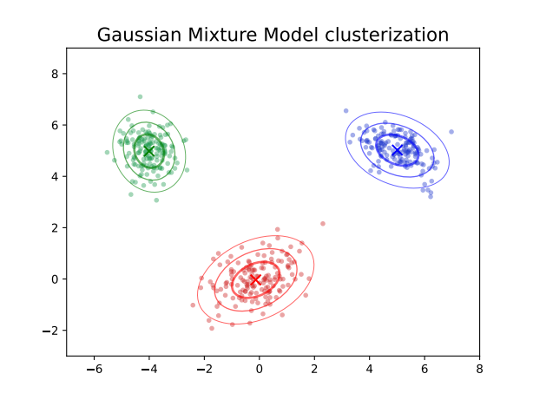
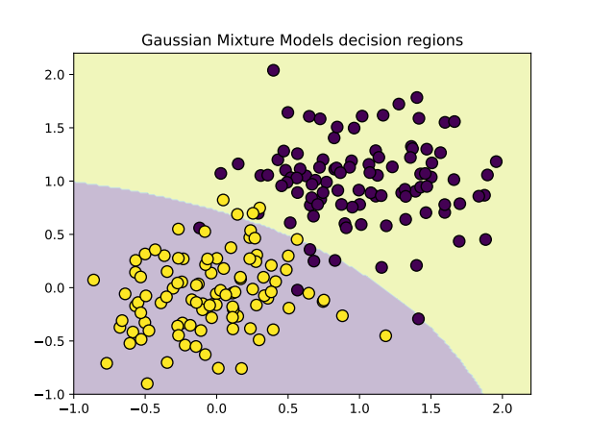
Gaussian Mixture Models
# Gaussian Mixture Models
from sklearn.mixture import GaussianMixture
gmm = GaussianMixture(n_components=2, covariance_type='full', random_state=0, n_init=10)gmm.fit(X)
example: clustering in 2D

Slide 16
Gaussian Mixture Models
technical slide: the Expectation–Maximization (EM) algorithm
  start from an initial guess
  compute “responsibilities”
  (closest component weight)
  redefine parameters
  (attract to closest cluster)
  repeat until converges

Slide 17
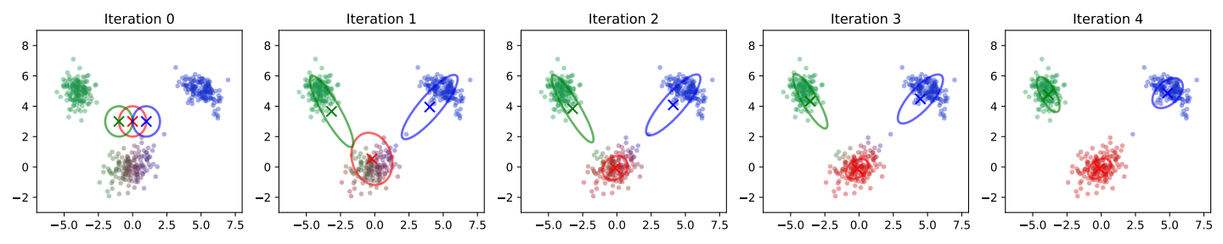
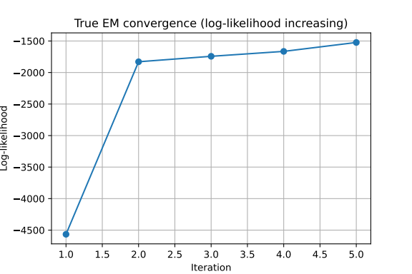
Gaussian Mixture Models
technical slide: the Expectation–Maximization (EM) algorithm

Slide 18
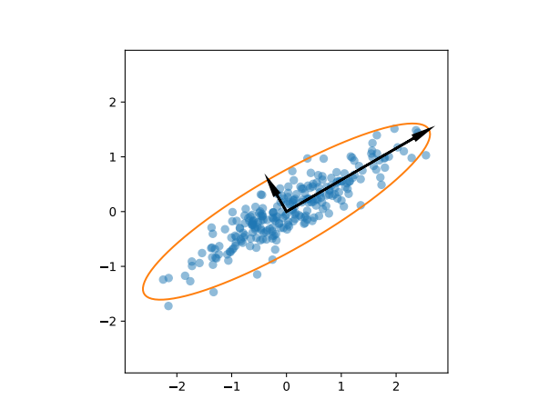
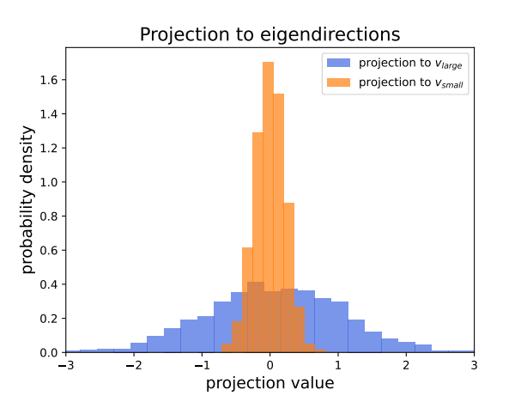
Principal Component Analysis (PCA)
choose an orthonormal coordinate system aligned with the data!
we fitted an ellipsoid → find the eigenvectors
  smallest eigenvalues: data vary the least
  largest eigenvalues: data vary the most

Slide 19
Principal Component Analysis (PCA)
PCA: keep only largest eigenvalues
  compression → descriptive features
  noise reduction
  representation of the largest changes
small eigenvalues:
  approximately constant for all data in a class
  classification → selective features
  laws

Slide 20
Principal Component Analysis (PCA)
technical slide: compression with PCA
eigenvalue = projection value squared
PCA values: for the largest eigenvalues → fewer data

Slide 21
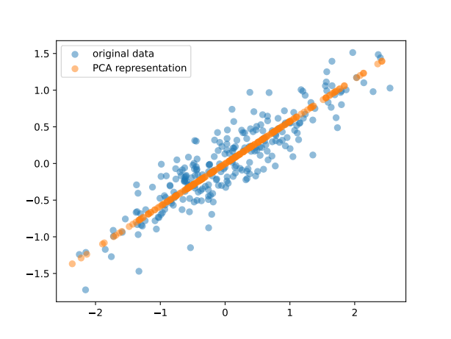
Principal Component Analysis (PCA)
technical slide: data reconstruction with PCA
most information is in the subspace of largest eigenvalues
therefore
# PCA representation of data
from sklearn.decomposition import PCA
pca = PCA(n_components=1)
data_pca=pca.fit_transform(data.T)
data_reconstructed=pca.inverse_transform(data_pca)

Slide 22
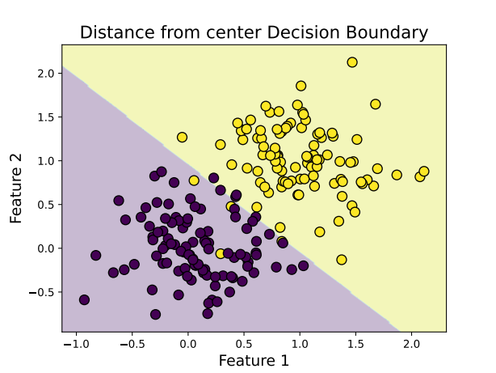
Principal Component Analysis (PCA)
classification with laws → LLT
smallest eigenvectors of the PCA matrix → laws
classification features:
  if small value
  if usually a larger value
so is the smallest for the true class index
  if r=1: distance from the centre

Slide 23
END OF LECTURE 11

